Slide 1
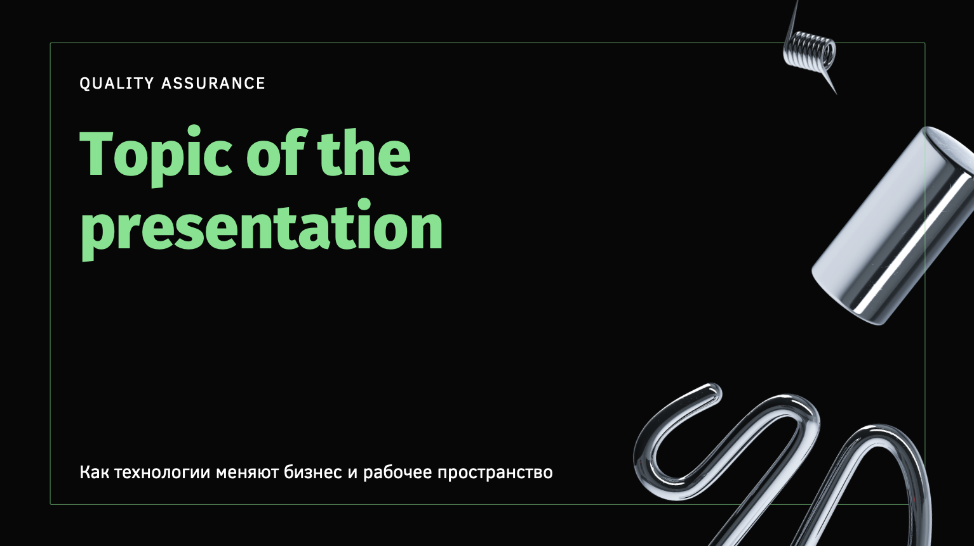
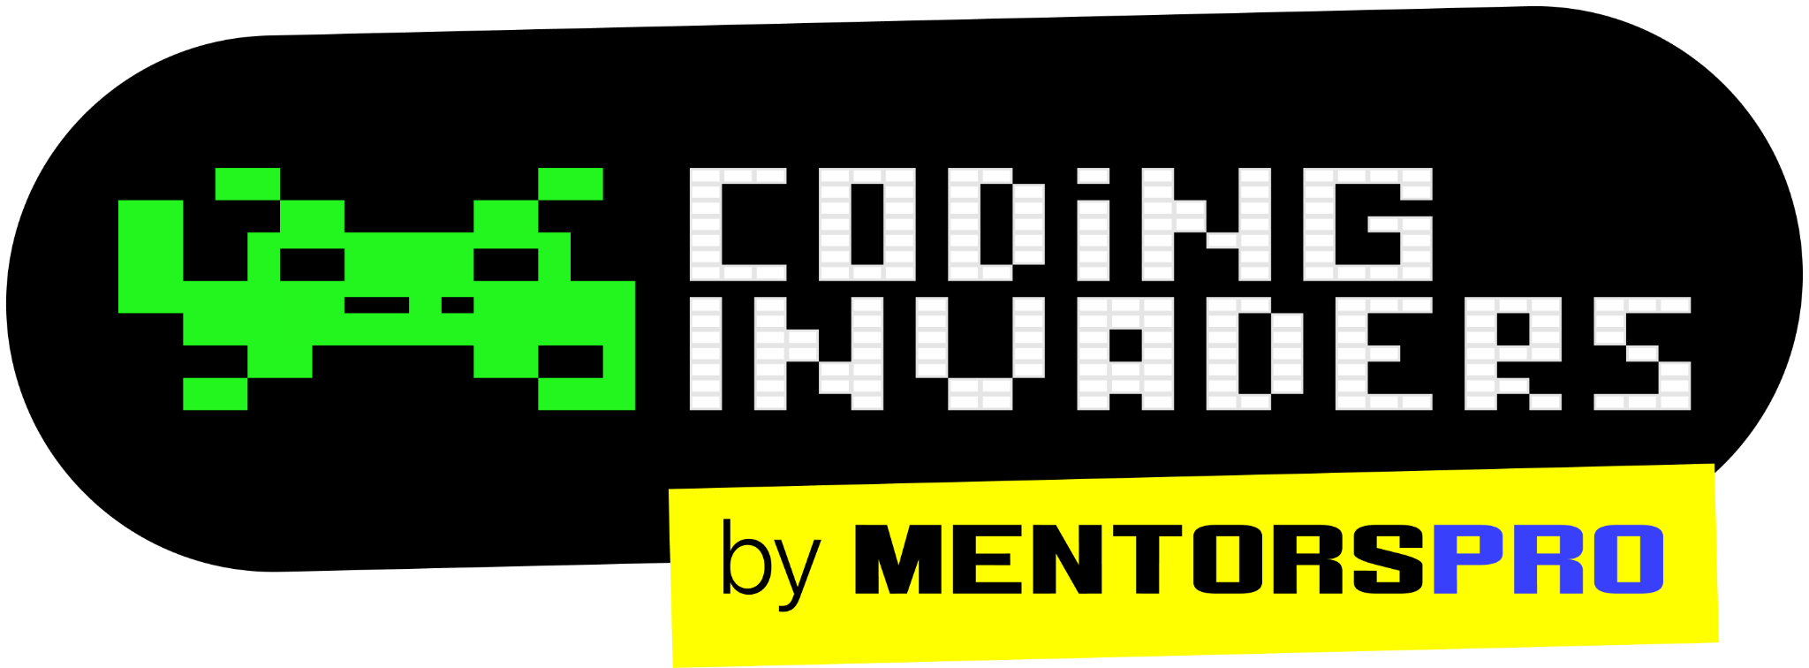
QA Automation Engineer
“Software Testing Types”
Miscellaneous Testing Concepts
Content Title
Notes:
Title - Fira Sans, 50pt
Subtitle - Fira Sans, 16pt

Slide 2
Types of Testing
Smoke Testing
Sanity Testing
Installation Testing
Black box testing
White Box Testing
System Testing
Regression Testing
Performance Testing
Usability Testing

Slide 3
User Acceptance Testing (UAT)
User Acceptance Testing (UAT) is a type of testing performed by the end user or the client to verify/accept the software system before moving the software application to the production environment.
UAT is done in the final phase of testing after functional, sanity and system testing is done.
The main Purpose of UAT is to validate end to end business flow. It does not focus on cosmetic errors, spelling mistakes or system testing. User Acceptance Testing is carried out in a separate testing environment. It is kind of black box testing where two or more end-users will be involved.

Slide 4
Positive Testing
Performing the Testing on the application with positive data or valid data is called Positive Testing.

Slide 5
Negative Testing
Performing the Testing on the application with negative data or invalid data is called Negative Testing.

Slide 6
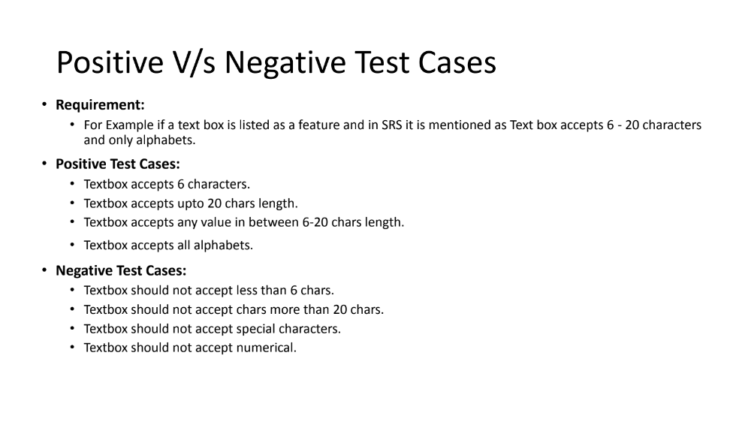

Slide 7
Integration Testing
Integration Testing is level of software testing process, where individual units of an application are combined and tested.
Individual software are combined and tested.

Slide 8
Roles and Responsibilities of a Manual Tester
Following are the roles and responsibilities of a Manual Tester:
Analyzing the client requirements.
Establishing the test environment for executing the test cases.
Analyzing and Running the test cases.
Arranging Review Meetings.
Communicating with the users to understand the product requirements.
Interacting with the Test Manager.
Defect Tracking.
Evaluating the testing results on bugs, errors, database impacts, and usability.
Preparing the reports on all the activities carried out while testing the software and reporting to design time.

Slide 9
Advantages of Manual Testing
It does not require programming knowledge while using the Black box method.
It is used to test dynamically changing GUI designs.
Tester interacts with software as a real user so that they are able to discover usability and user interface issues.
It ensures that the software is a hundred percent bug-free.
It is cost-effective.
Easy to learn for new testers and freshers.

Slide 10
Disadvantages of Manual Testing
It requires a large number of human resources.
It is very time-consuming.
Tester develops test cases based on their skills and experience. There is no evidence that they have covered all functions or not.
Test cases cannot be used again. Need to develop separate test cases for each new software.
It does not provide testing on all aspects of testing.
Since two teams work together, sometimes it is difficult to understand each other's motives, it can mislead the process.

Slide 11
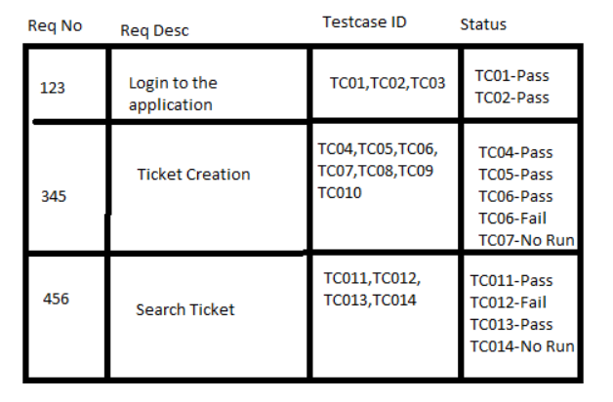
What is Requirement Traceability Matrix?
Requirement Traceability Matrix (RTM) is a document that maps and traces user requirement with test cases. It captures all requirements proposed by the client and requirement traceability in a single document, delivered at the conclusion of the Software development life cycle. The main purpose of Requirement Traceability Matrix is to validate that all requirements are checked via test cases such that no functionality is unchecked during Software testing.

Slide 12
Advantage of Requirement Traceability Matrix
It confirms 100% test coverage
It highlights any requirements missing or document inconsistencies
It shows the overall defects or execution status with a focus on business requirements
It helps in analyzing or estimating the impact on the QA team’s work with respect to revisiting or re-working on the test cases

